Slide 1
Computer Vision
Blockweek

Slide 2
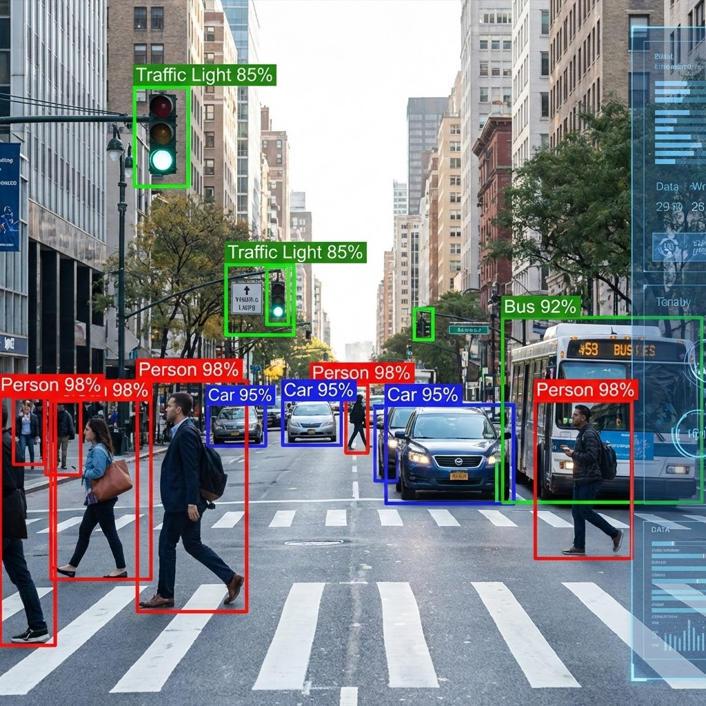
Course Blockweek schedule
Monday - Tuesday: Dimitris Mousadakos
Topics: Intro to CV, CNNs, Transfer learning
Start: 08:15
Safouane El Ghazouali: Wednesday - Friday
Topics: Transformers, ViTs, YOLO
Start: 08:30
Friday: live online
Passing the course: Final project
Create groups of 2, submit your project proposal by
Sunday, February 1st
Final project presentations: March-April (TBD)

Slide 3
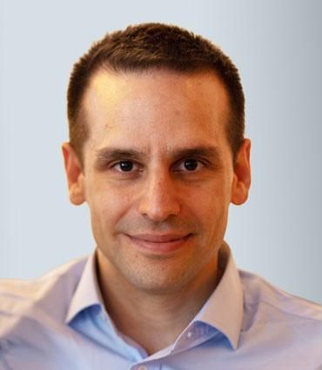








About me
Physicist turned to Data Scientist
PhD in Physics at
10+ year in Data Science / Data Engineering
Co-Founder of
Data Science & Entrepreneurship
Dr. Dimitris Mousadakos

Slide 4
About you

Slide 5



Do not edit
How to change the design
What is your background?
Presenting with animations, GIFs or speaker notes? Enable our Chrome extension
Notes:
📣 This is Slido interaction slide, please don't delete it.
✅ Click on 'Present with Slido' and the poll will launch automatically when you get to this slide.

Slide 6
Do not edit
How to change the design
Why you want to learn Computer Vision?
Presenting with animations, GIFs or speaker notes? Enable our Chrome extension
Notes:
📣 This is Slido interaction slide, please don't delete it.
✅ Click on 'Present with Slido' and the poll will launch automatically when you get to this slide.

